Slide 1

Welcome
Notes:
Welcome slide.

Slide 2
Introduction
Md. Hasan Hafizur Rahman
Lecturer & Head of the Department (English) Cambrian School & College, Campus-5, Baridhara, Dhaka | Lesson Description Class-VIII English 2nd Paper
Notes:
Introduction.

Slide 3
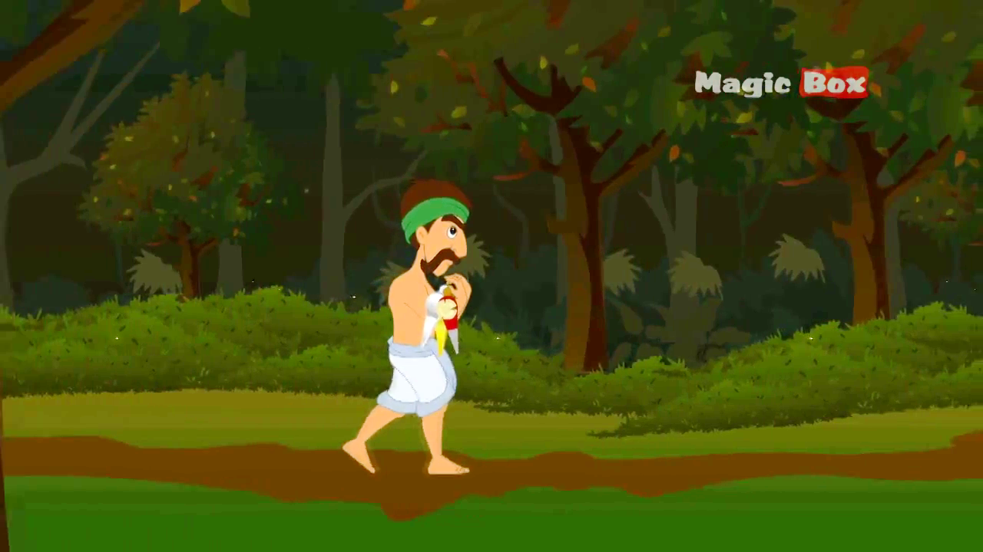
Do you know anything about this picture?
Notes:
This picture is to test that the students are familiar to the story “The honest wood cutter” or not.

Slide 4
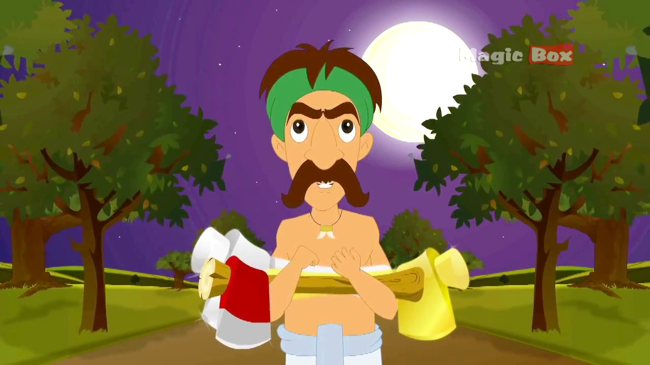
The wood cutter was awarded with all the three axes for his honesty.
Notes:
Bothe Concrete & Abstract noun are shown in the text.

Slide 5
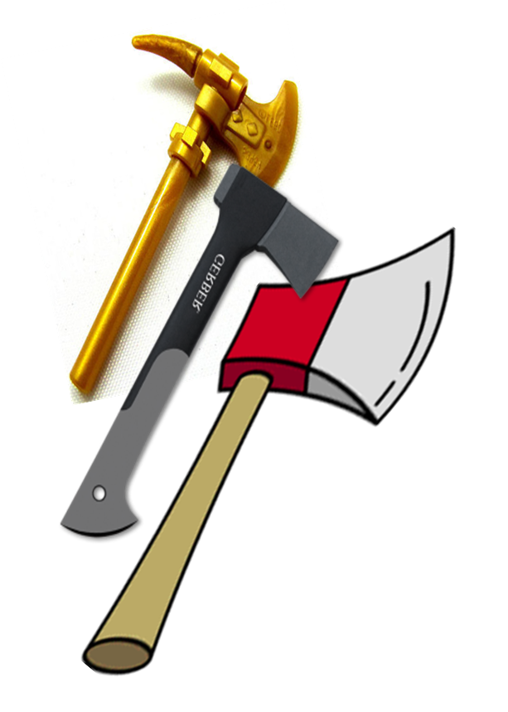
Follow
Axes
A material used for cutting.
A visible name of an object.
Notes:
Teacher will make the students understand material noun through this slide.

Slide 6
Follow
Honesty
Unseen
Name of a quality.
Invisible name
of a quality.
Notes:
Teacher will ask the students to focus the main theme of abstract noun.

Slide 7
Can you guess what are we going to discuss today?
Noun
Notes:
Suspension to lesson declaration.

Slide 8
Learning outcomes
After we have studied this lesson, we will be able to ----
explain noun and its classifications
define the definition of nouns
identify nouns
Notes:
This is the target of this lesson.

Slide 9
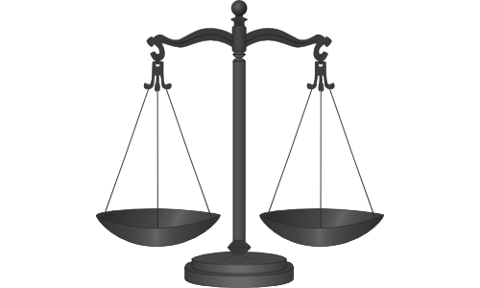
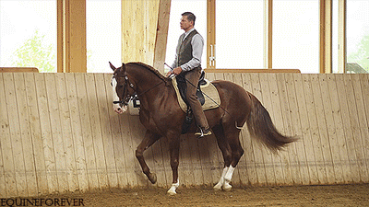
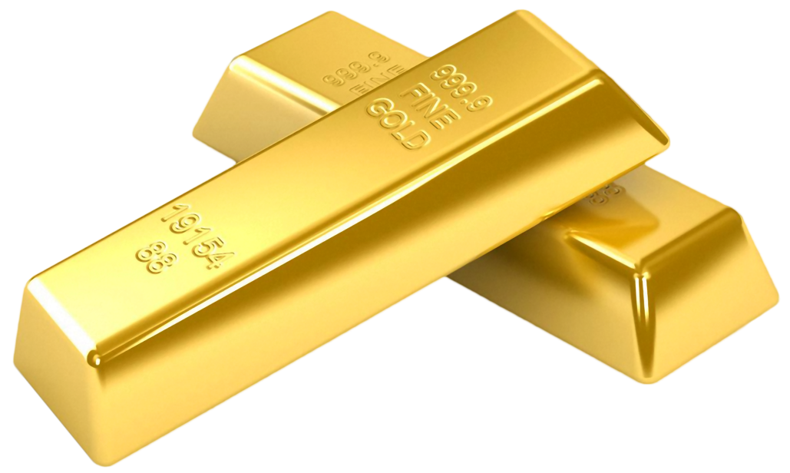

Honesty
Horse, rider
What kind of words have you observed?
Naming words
A noun is the name of anything.
Gold
Determination
Notes:
Teacher will take out the naming word showing the pictures.

Slide 10
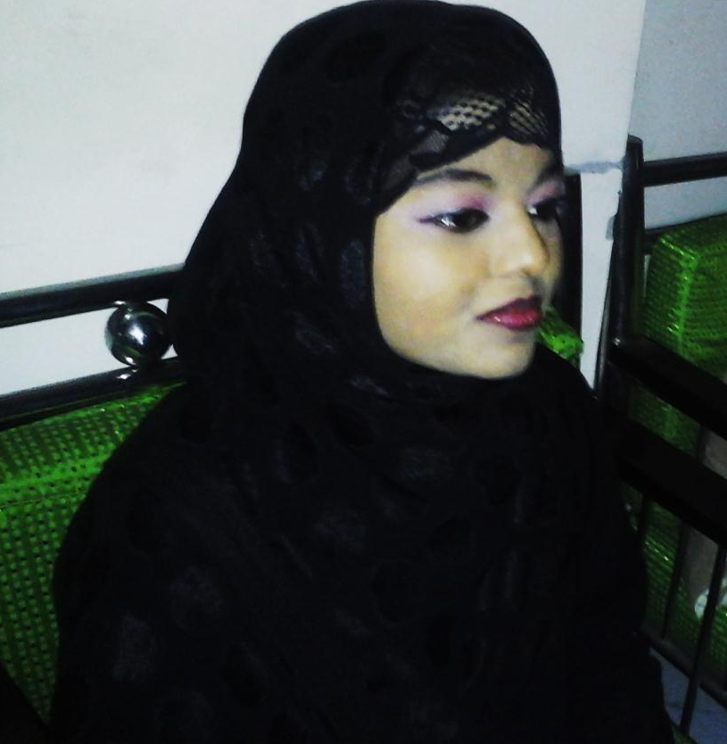
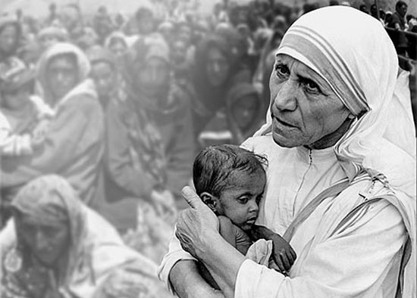
Sumaia is a girl.
Kindness is a noble virtue.
Visible(দৃশ্যমান)
Invisible (অদৃশ্যমান)
Concrete Noun
Abstract Noun
Notes:
Main discussion of two nouns.

Slide 11
What are the classifications of noun?
Nouns are mainly classified into two kinds
Concrete Noun
দেখা যায়,ধরা যায়, ছোঁয়া যায় এমন সব নাম
Abstract Noun
গুণবাচক নাম যা দেখা যায় না, ধরা যায় না, ছোঁয়া যায় না
Notes:
Teacher will ask the students to tell the classification of noun according to previous discussion.

Slide 12
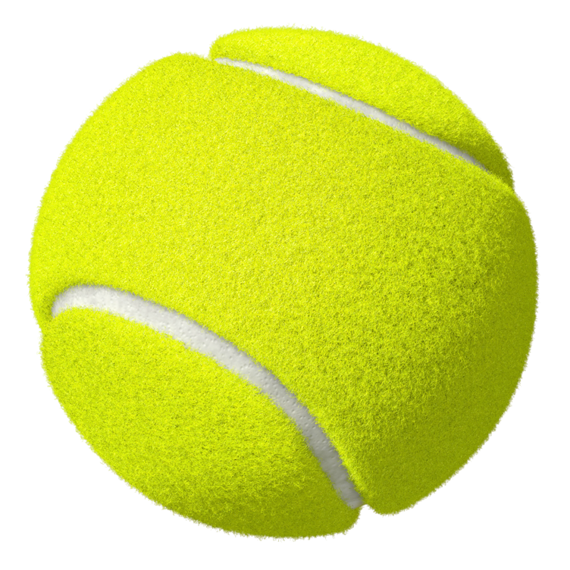
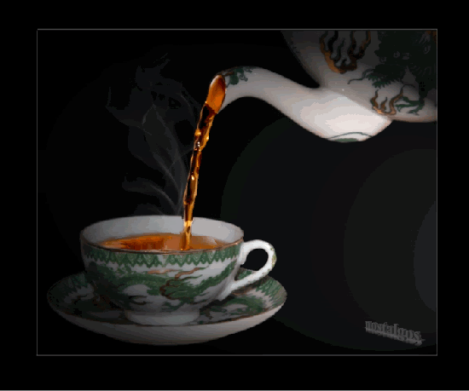
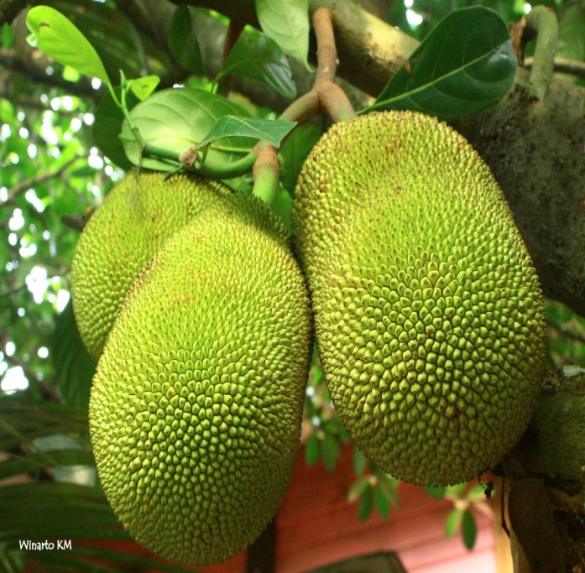
Make sentences with the pictures.
The ball looks green.
Tea refreshes our mind.
We like jackfruit very much.
Ball, tea and jackfruit are concrete noun.
Notes:
Teacher may ask the students to find out concrete noun through making the sentences.

Slide 13

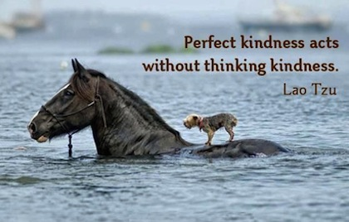
Explain the picture.
love
kindness
An abstract noun is a type of noun that has no physical existence.
Notes:
Teacher may take out the definition of abstract noun though the pictures.

Slide 14
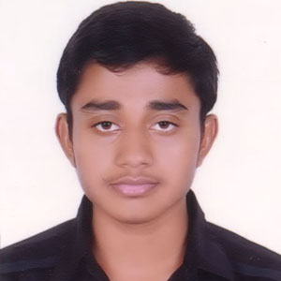
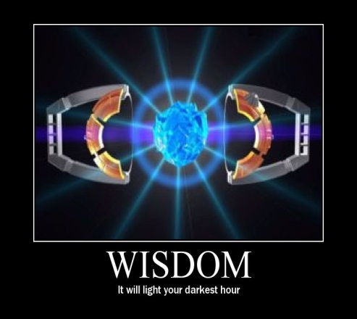




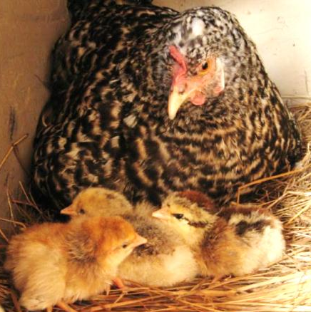

Identify concrete & abstract noun below.
Concrete
Abstract
Abstract
Concrete
Concrete
Abstract
Concrete
Abstract
Notes:
Teacher may ask the students to identify the concrete and abstract noun showing the pictures.

Slide 15
Generally Abstract Nouns are formed with some suffixes like--------
ness
tion
hood
ship
kindness
preparation
boyhood
scholarship
ment
ce
th
ty
excitement
importance
depth
ability
and so on.
Notes:
Students will be supposed to tell a word with a single suffix to make a sentence.

Slide 16
Pair Work
Identify the concrete and abstract nouns of the bold Italic words from the passage below.
Mother is the most blessing of Allah. Her love is divine. The kindness of mother is incomparable. She always takes care of her children. She provides her child with good foods, beautiful dresses. If her child falls in any danger, she stays in anxiety. A mother does her best for the betterment of her children. She always gives inspiration to her children to succeed in life. So we should take care of her cordially.
Notes:
Each two students will do the task.

Slide 17
Evaluation
Answer the following questions.
What is concrete noun?
What is the main characteristic of concrete noun?
What do you mean by abstract?
How is abstract noun normally formed?
How can you recognize abstract noun?
Notes:
Teacher may take feedback asking the questions

Slide 18
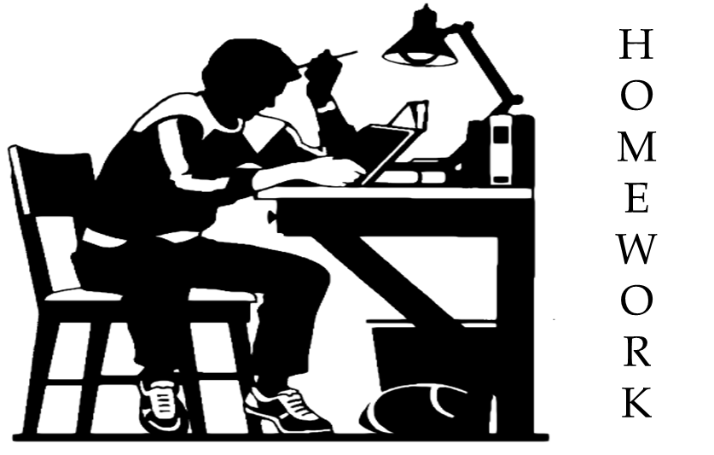
Write down at least five examples / names of concrete and abstract nouns from your surrounding environment.
Notes:
Assignment.

Slide 19
Verse Universal
It is very easy to defeat a man with strength but it is very difficult to control your emotions.
Notes:
This is a Hadith.

Slide 20
Assalamu Alaikum Warahmatullah.
Notes:
Last greeting.

Slide 21
Acknowledgement
We would like to express our cordial gratitude to the Ministry of Education, Directorate of Secondary & Higher Education, NCTB, A2i and the panel of honorable editors ( Md. Jahangir Hasan, Assistant Professor (English) TTC, Rangpur, Ranjit Poddar, Associate Professor (English) TTC, Dhaka, and Urmila khaled, Assistant Professor (English) TTC, Dhaka, to enrich the contents.

